Slide 1
STEAM National Parks

Slide 2
There are approximately 84.4 million acres of land in the National Park System.

Slide 3
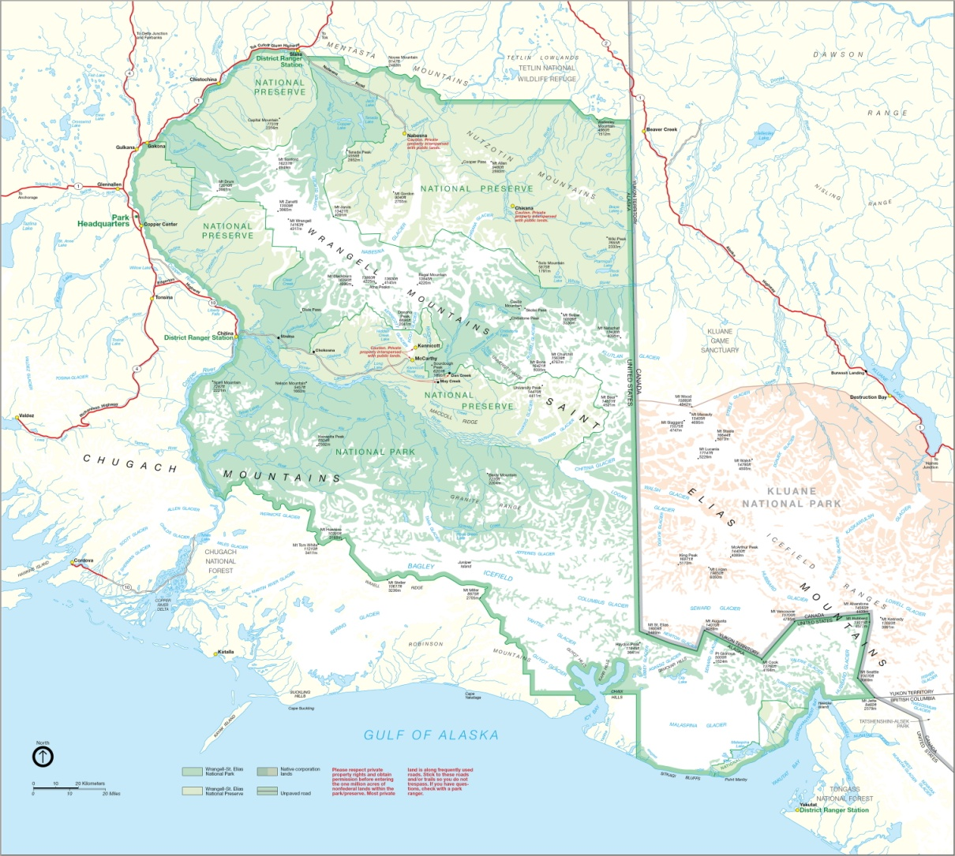
The largest National Park is Wrangell St. Elias National Park in Alaska.
13,200,000 acres

Slide 4
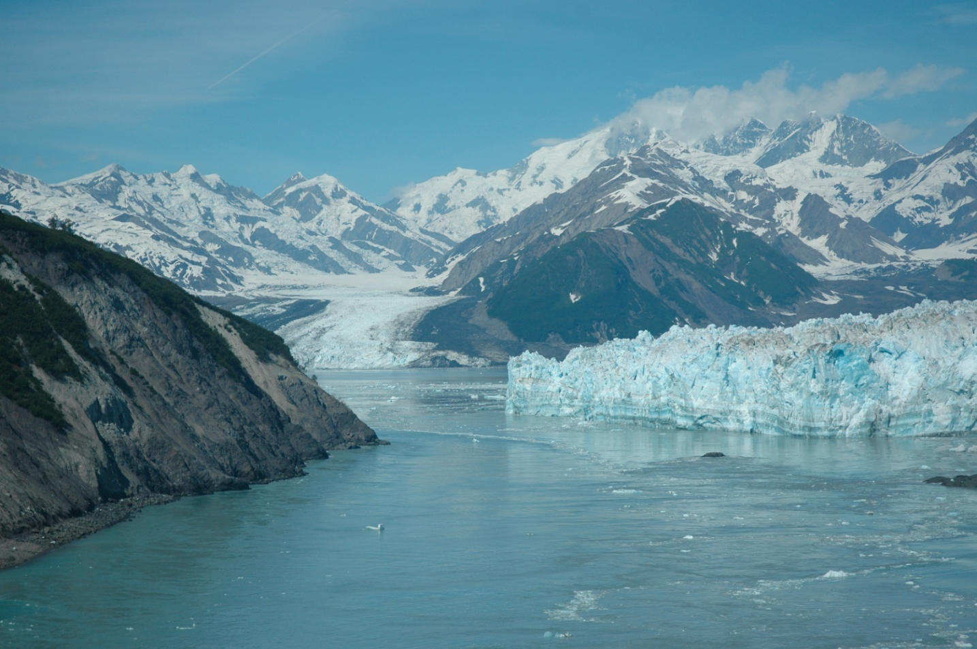
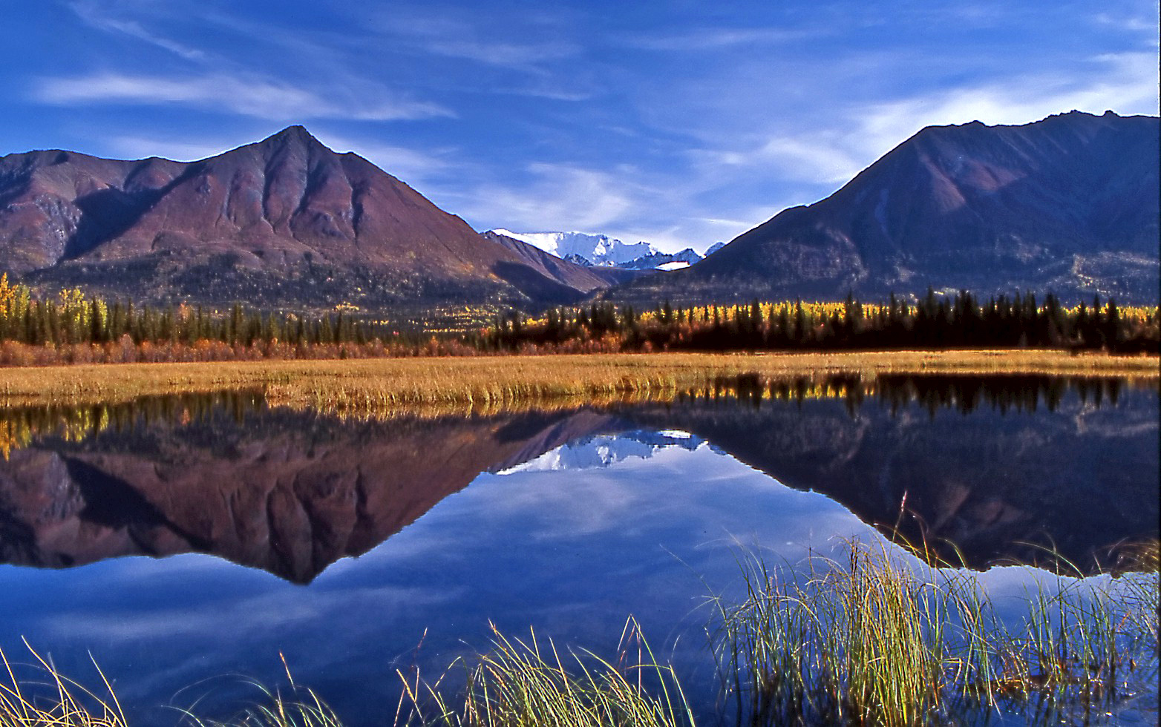
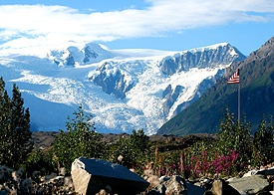
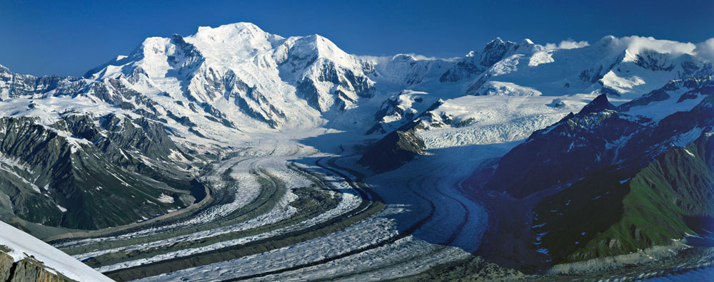

Slide 5
Directions
Find the acreage of 4 parks that are a part of the National Park System
1st - Google search “National Parks in (choose a state)
2nd - Gather the names of 4 national parks
3rd - Search, “How many acres is (national park name)”
Then find the difference from the 84.4 million acres of land
Subtract the National Park acreage from 84,400,000
**Don’t forget to line up your place values!
Next, combine/total up all your acreage from your chosen parks.
Lastly, find a fact about each of your chosen parks

Slide 6
Example:
84,400,000 total National Park acreage
-13,200,000 Wrangell St. Elias National Park acreage
71,200,000 difference
Showing your work is required for this STEAM poster

Slide 7
STEAM National Parks
S scientifically researched facts and acreage
on national parks
T used technology to look up
information about the National Parks
E Engineered a STEAM poster
A Created an artistic poster
M Found the difference using the total
National Park acreage and found the total
of combined parks

Slide 8
Requirements:
Title
Difference of 4 parks
Total of all parks
Facts for each park
Work shown
Art
STEAM portion

